Slide 1
Design and Implementation of a C Code Generator Module for the Gamma Statechart Composition Framework
Nagy Levente Márk
Advisor: Graics Bence

Slide 2
Fancy title, but..
What is the Gamma Statechart Composition Framework?
Why do we need Code Generators?
From where do we generate code?
What technologies are being used?
How do we achieve platform independence?
Especially in timing
How do we utilize the generated code?

Slide 3
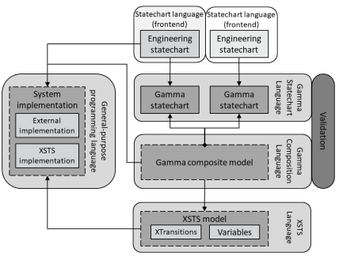
The Gamma Framework
What is Gamma?
Eclipse extension
Composite Statecharts
From statecharts & interfaces designed in Yakindu
Formal Verification of composite systems
Through a model-checker, UPPAAL, Theta, Spin
Code Generation for various platforms
Gamma contains a code generator for java
Verification of the generated code
Unit tests based on a model-checker should cover the state space
C, Java implementations

Slide 4
Code Generators
Why do we need?
Efficiency - no need for manual coding
Accuracy - reduce the risk of human error
Consistency - enforcing model-code behavior consistency
Maintainability - code maintenance by regenerating code
Portability - can generate code for different platforms
Potential presence of bugs in code generators, could we verify the results?

Slide 5
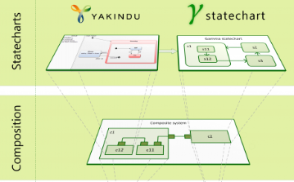
Technologies used
What technologies?
XSTS language
Intermediate representation of our model
Eclipse
Gamma is an eclipse plugin
The XSTS language is implemented using EMF, serialized to XML
Dependencies integrated into Eclipse: Yakindu, PlantUML, etc..
Xtend
Java dialect, java code is being generated in the background
Commonly used in code generators, serializers instead of instanceof

Slide 6
The XSTS Language
XSTS definitions
What technologies?
Declarations
Type, Variable declarations
Variable groups, annotations, e.g.: input groups, clock variables
Initializations
Initial values, initialize the component
Reset inputs, outputs between cycles
Transitions - the internal mechanism of the model
Consists of..
Actions, Expressions
type Main_region_Controller : { __Inactive__, Operating, Interrupted }
var PoliceInterrupt_police_In_controller : boolean = false
var BlinkingYellowTimeout3_secondary : integer = 0
XSTS serialized to XML
<typeDeclarations name="Main_region_Controller">
<type xsi:type="hu.bme.mit.gamma.expression:EnumerationTypeDefinition">
<literals name="__Inactive__"/>
<literals name="Operating"/>
<literals name="Interrupted"/>
</type>
</typeDeclarations>

Slide 7
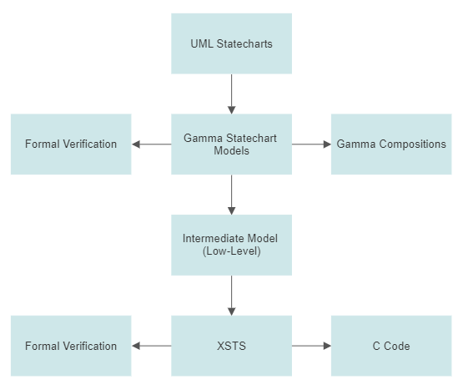
Model Transformation
From where?
UML Statecharts
Transformed to gamma statechart language
Gamma Components
Transformed into XSTS with an extra intermediate step
XSTS Model
Used to generate C code
Can be used to formally verify the component

Slide 8
Implementation
What technologies?
Regions as enums
For each component..
2 source & 2 header files are being generated
Statechart component
Implements the behavior of its model
Resets in-, outputs between cycles
Declares all required structure
Wrapper component
Handles timing
Hides the internal mechanism
Provides Ports (in the form of setters/getters)
enum Main_Region_Controller {
__Inactive___main_region_controller,
Operating_main_region_controller,
Interrupted_main_region_controller
} main_region_controller;
typedef struct {
bool PoliceInterrupt_police_In_controller;
enum Main_Region_Controller main_region_controller;
enum Operating_Controller operating_controller;
/* … */
bool __id_Green_9_Yellow__secondary;
bool __id_Normal_18_Interrupted__secondary;
unsigned int BlinkingYellowTimeout3_secondary;
} CrossroadStatechart;
Components as structs

Slide 9
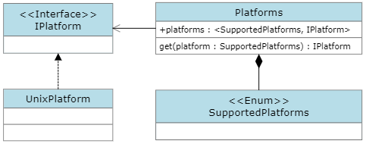
Platform independence
How do we achieve?
ISO Standard - standards for the C programming language
Extensive support from compilers
Timing - measure time elapsed
Little-to-no overlap between platforms
Similar structure between platforms
One class for each platform, contains the implementation
Central platform manager
Solution
Introduce a package for customized platform & timing handling

Slide 10
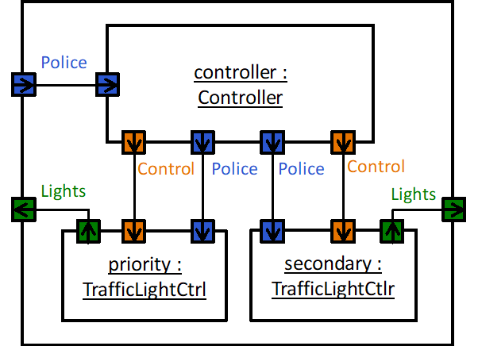
Case Study
The Crossroad Example

Slide 11
Utilization
Initialize statechart
CrossroadWrapper statechart;
initializeCrossroadWrapper(&statechart);
Initialization
Internal variables
Ports
Setters for input ports
Getters for output ports
Fallback to a default value after each cycle
Timing
At least 500 us of sleep required
Variables used for timing can overflow
Cycle - check whether a change in state is due
Ports as setters & getters
/* setters as input ports */
setPoliceInterrupt_police_In_controller(&statechart, detect(POLICE));
/* getters as output ports */ getLightCommands_displayRed_Out_prior(&statechart);
getLightCommands_displayRed_Out_secondary(&statechart);
Run cycles, sleep
runCycleCrossroadWrapper(&statechart);
usleep(2500);

Slide 12
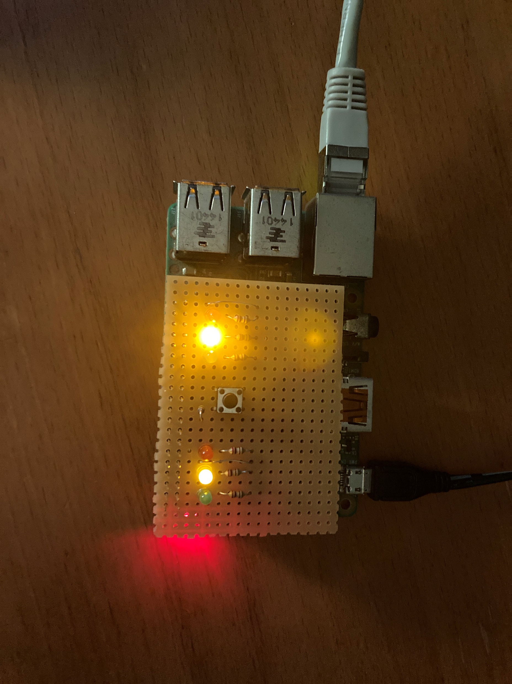
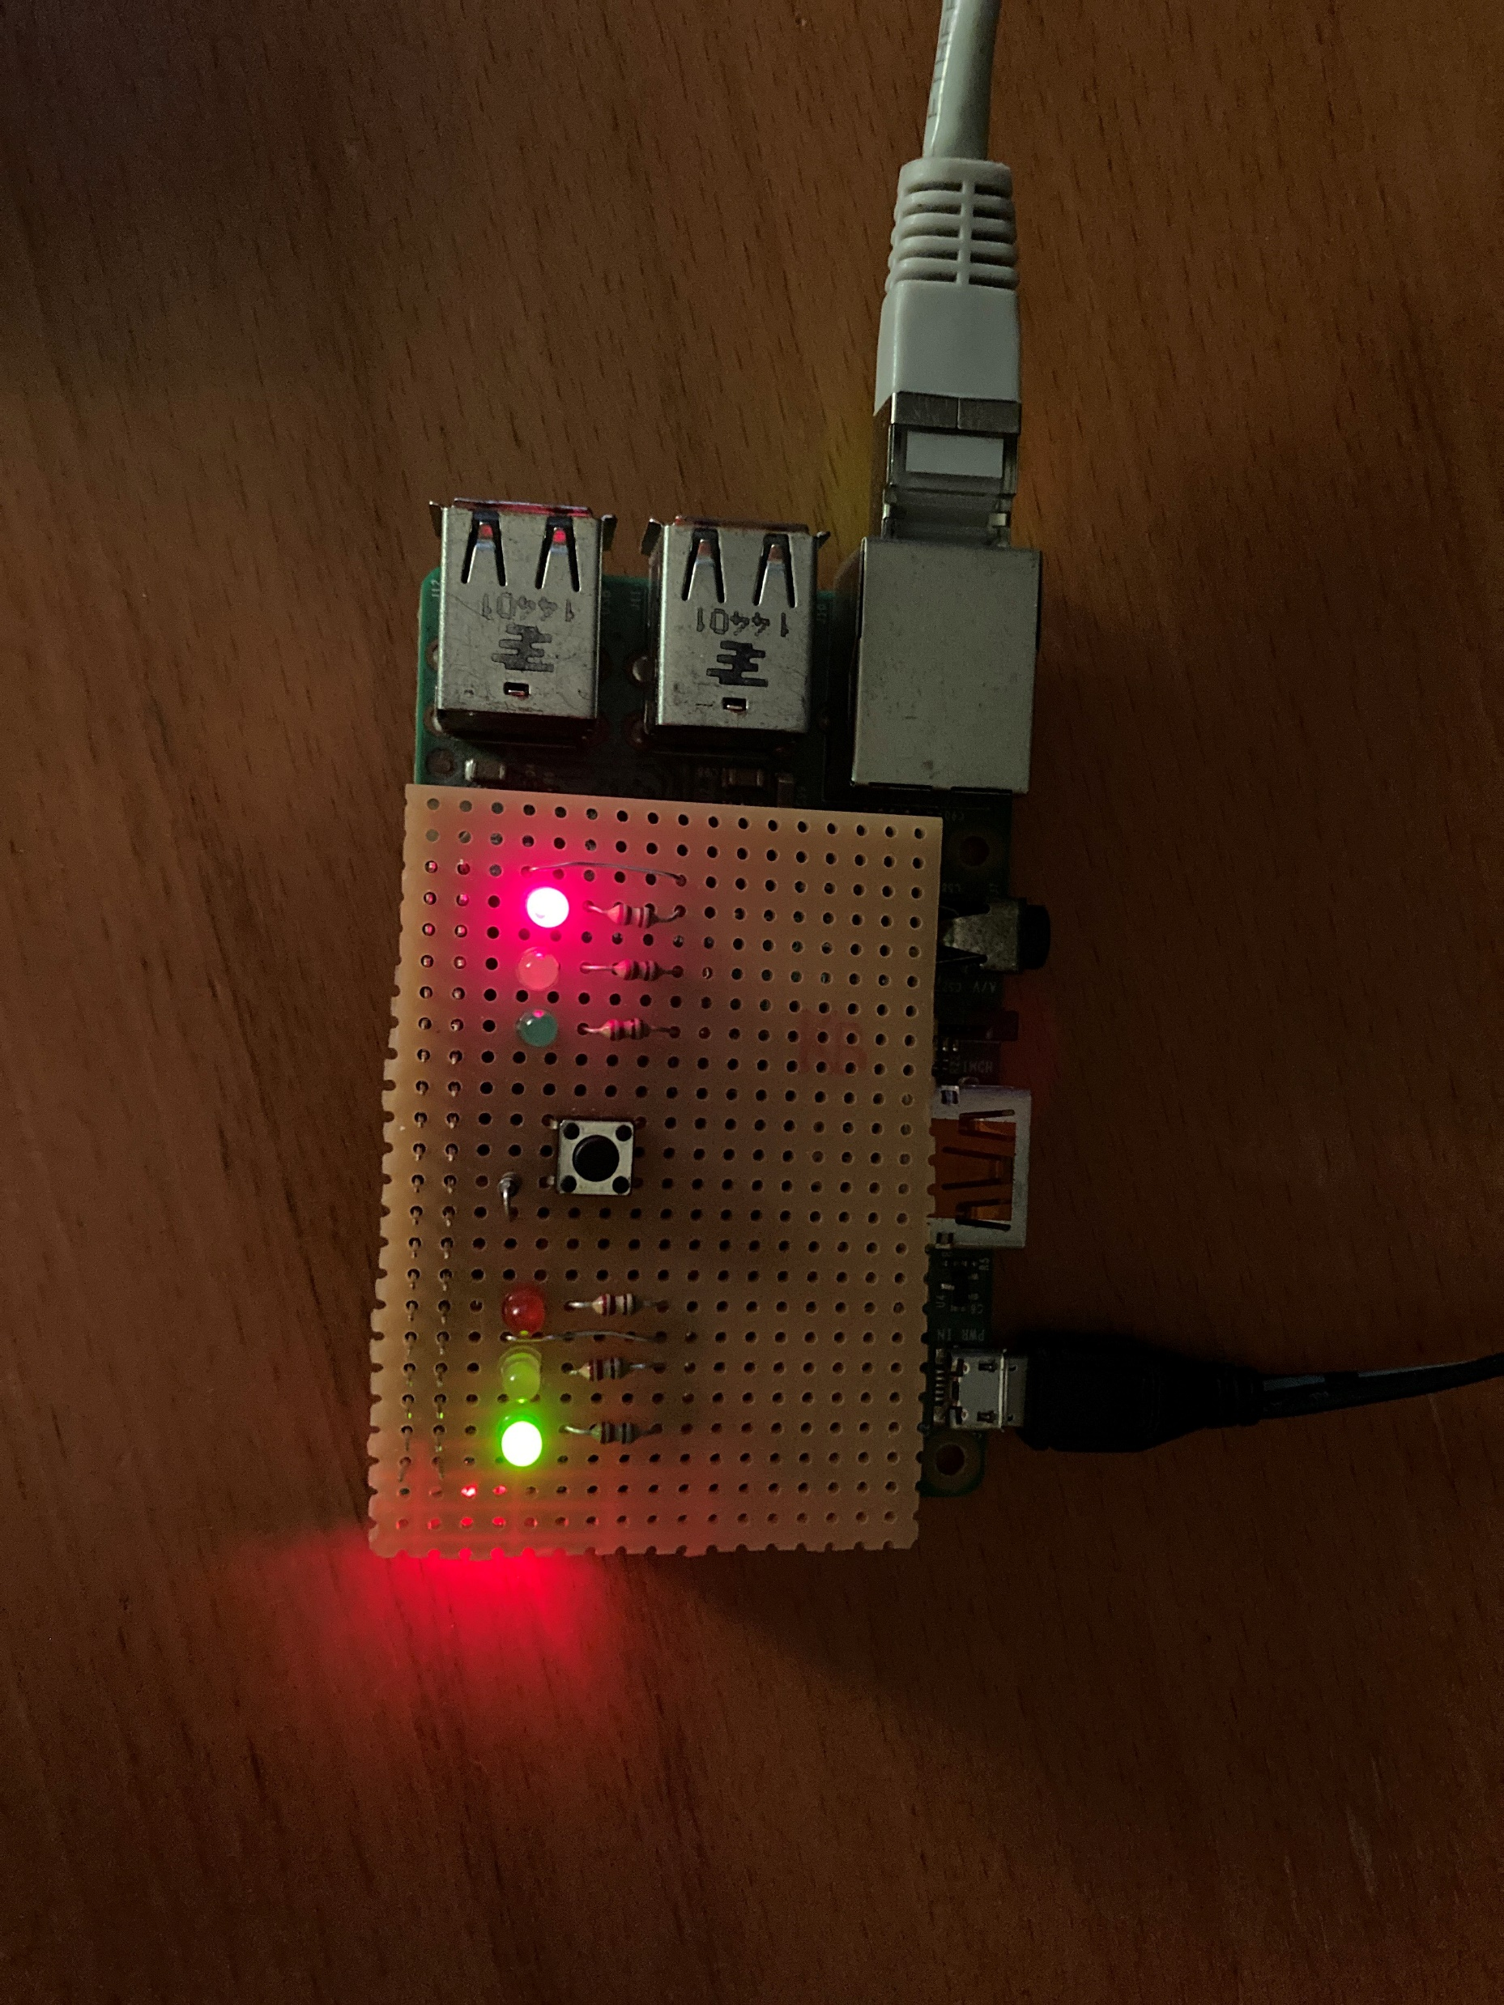
Results
Interrupted
Mode
Normal
Mode
#define PRIMARY_RED 8
#define PRIMARY_YELLOW 7
#define PRIMARY_GREEN 0
#define SECONDARY_RED 21
#define SECONDARY_YELLOW 23
#define SECONDARY_GREEN 25
Pin definitions
Police interrupt
Environment
GPIO pins
Could be something else
Compiled without
Errors, warnings
Timing for UNIX platforms
Works as intended
Primary lights
Secondary lights
Deployed
on a Raspberry Pi

Slide 13
Summary
C Code Generation from XSTS Models
Portability, accuracy, consistency, etc..
Ensure platform independent code
Case Study: The Crossroad Example
Future work
Support more platforms
Formal verification of the generated code using model-checkers
Consistency: the generated code will reflect the behavior of its models
Generation
Generate accurate and consistent code from gamma statecharts and composite models
Accuracy: fewer logical mistakes during coding

